Slide 1
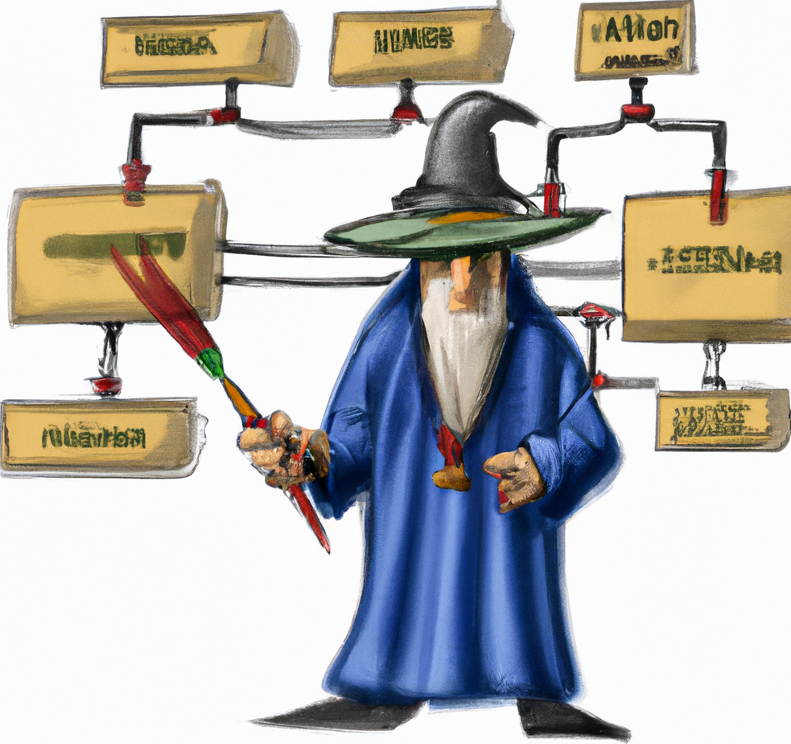
The Protocol Master
Impossible Testing at hand

Slide 2

Main features
Chaos Engineering: Simulate errors, rate limiting, responses
Fast Mock: Mock entire infrastructures in minutes
Simulate: Simulate non existing APIs
Protocols covered:
HTTP, HTTPS, Soap, REST,
MySQL, Postgres, Mongo Db, Redis RESP2, Redis RESP3
AMQP 0.9, MQTT 3, MQTT 5

Slide 3
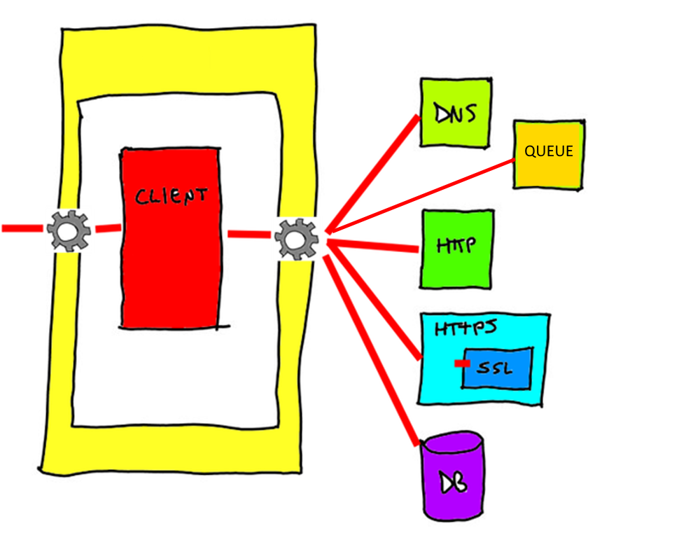
What it is
A proxy
An emulator
A mock

Slide 4
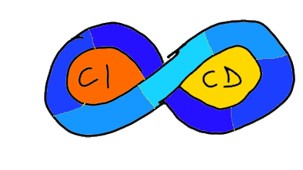








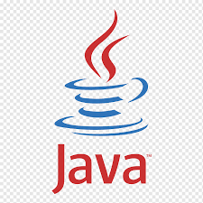

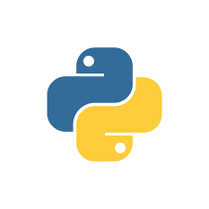
Environment
Run in
Local Proxy
Docker image
MITM
CI/CD Integration
Agnostic in respect of
Language
Infrastructure
Architecture

Slide 5
.net Core To-Do App – Chaos engineering
Tech stack:
.net Core
Entity Framework
MySQL
Steps
Setup locally
Rate limits
Errors
Notes:
Run TPM from command line
Run the .NET application locally in debug
Access the application via TPM proxy
Open at least 5 java rest
Introduce random errors
Introduce rate limits (refresh wildly)
http://localhost:8081/swagger-ui/index.html
http://java-rest/

Slide 6
.net Core To-Do App – Simulation
Tech stack:
.net Core
Entity Framework
MySQL
Steps
Setup on Docker
Record
Replay DB
Replay API
Notes:
This is the full infrastructure recording

Slide 7
Python Stock Quotes App – Queue Simulation
Tech stack:
Python
Bottle (“mini” Flask)
Peewee
RabbitMQ
MySQL
Steps
Setup
Record
Replay Broker
Send message manually
Notes:
This is the full infrastructure recording

Slide 8
Other features
Plugin based
Event based architecture
Mock specific requests
Rewrite request responses
Expose custom API (with Swagger)
Run via command line
SSL MITM approach
All is JSON

Slide 9
Random Tech stuffs
Custom DI Engine
Custom Web Routing engine
Pf4j-based plugins
Behavior Tree/FSM byte level protocol parsing
78% test coverage
Transform SQL queries
Reimplemented default Java http server to reload SSL certificates dynamically
Easily extensible with other protocol

Slide 10
Next steps
A decent UI
Kafka
Amqp 1.0
SQL Server

Slide 11
Finally
http://www.github.com/kendarorg
https://www.linkedin.com/in/enricodaros/
enrico.daros@gmail.com

